Slide 1
FIT TO JOB
Flow of Fit to Job Exam

Slide 2
Make Question Paper
Assign Question Paper to Employee(Dept / Work/Post Wise
Login in Exam Portal with Mobile no with OTP or Master OTP
Read Exam Rule and Start Exam
Show Assign Test Paper List with Details (Date / Time/Subject. ETC

Slide 3
Show Assign Test Paper List with Details (Date / Time/Subject. ETC
Fill Question Ans. And Submit Paper
On Final Submit Get Exam Result
Fail
Pass
Got Marks 80 or more than
Got Marks Less than 80
Get Digital Certificate of Fit to Job on Mobile App
Training till Next Fit to Job Exam

Slide 4
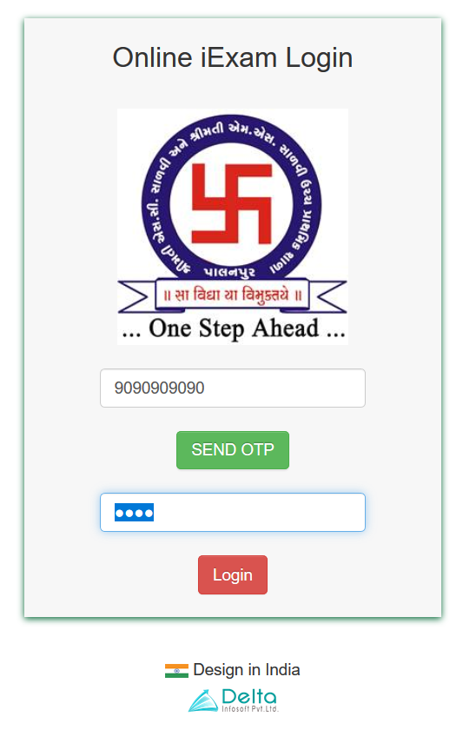

એક્ષામ આપવા માટે
http://fittoJob.dukeplasto.com
વેબ-સાઈટ પર જવાનું રહેશે
Mobile No. અને OTP એન્ટર કરવાનું રહેશે.
[ OTP - તમારા રજીસ્ટર કરેલા mobile no. પર આવશે ]

Slide 5
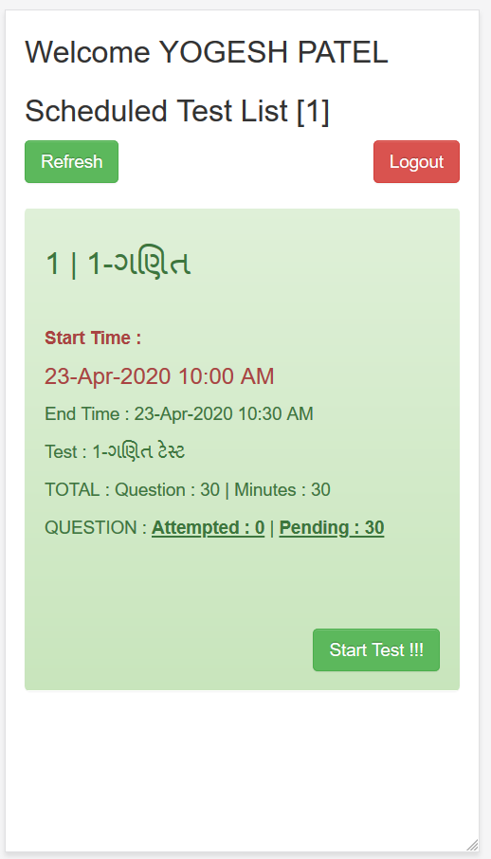
તમને આપેલા ટાઈમ ટેબલ મુજબ
ટેસ્ટ ડિસ્પ્લે થશે ,
તમારે સ્ટાર્ટ ટેસ્ટ [ Start Test ]
પર ક્લિક કરવાનું રહેશે

Slide 6
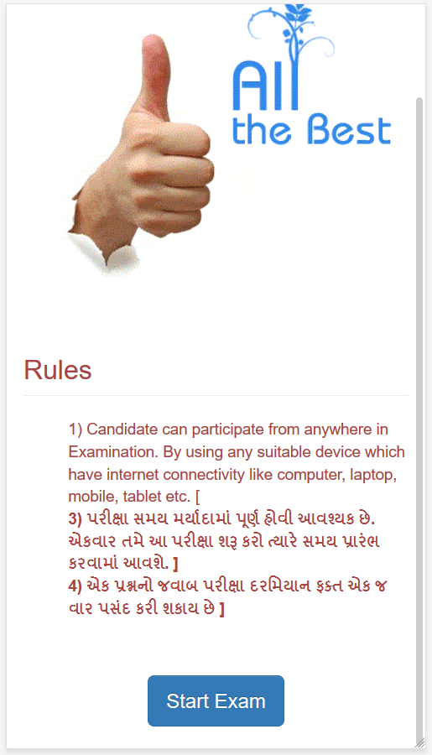
એપ્લિકેશન તમારુ લોગીન ચકાસી
રૂલ્સ ડિસ્પ્લે કરશે.
તમારે રૂલ્સ વાંચન કારીયા પછી
સ્ટાર્ટ એકઝામ [ Start Exam ]
પર ક્લિક કરવાનું રહેશે

Slide 7
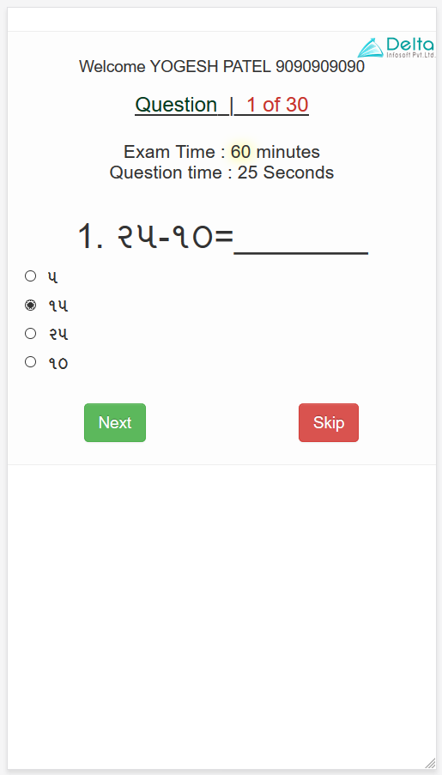
દરેક પ્રશ્ન આ રીતે
ડિસ્પ્લે થશે.
તમારે સાચા જવાબ ને સિલેક્ટ કરીને નેક્સટ [NEXT] ક્લિક કરવાનું રહેશે
જો તમને જવાબ સિલેક્ટ ના કરવો હોઈ તો સ્કિપ [ SKIP ] ક્લિક કરવાનું રહેશે

Slide 8
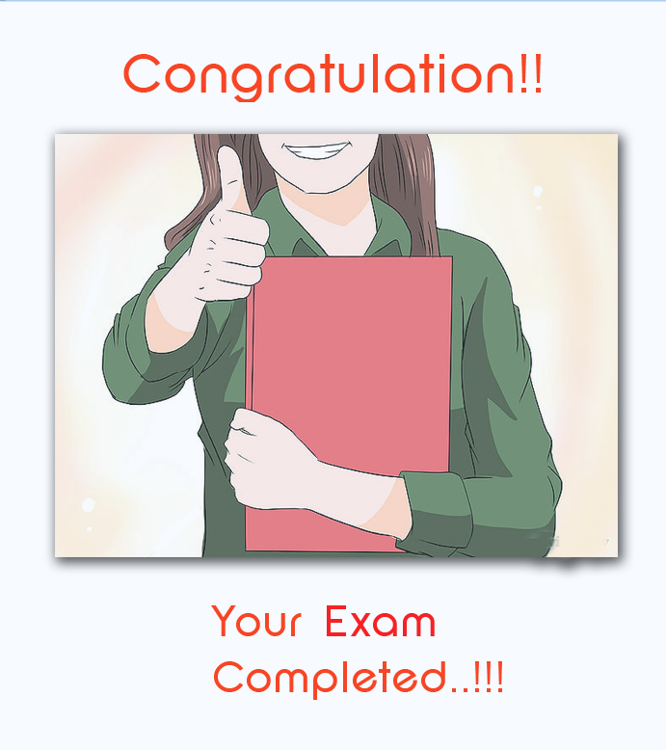
બધા પ્રશ્ન પુરા થયા પછી આ કમ્પ્લેટ મેસેજ ડિસ્પ્લે થશે. Thank you

Slide 9
Duke Team Suggestions
1. Add master related data in PPT
2. ABCD system in exam ( Random Question to Each Candidate )
3. Generate question with answer and with two type option – image and text
4. Master As per following
a. Job Profile
i. Subject
1. Question
5. Give option of some subject relate to all job profile
6. Question Paper Name option
7. Exam time – give option period wise (Like – 01-Jul-22 to 15-Jul-22, Time – 08:00 AM to 05:00 PM)
8. Question Import option
9. Give Absent and Present Report with all filter
10. Portal Name :- fittojob.dukeplasto.com
11. Option of exam set – post wise and department wise
12. Show all paper list in User login and show pending exam with different colour
13. Show exam status and certificate in iHR application
14. Show History wise marks report with all filter
15. Every Quarter Exam
16. Practical exam marks add option with subject wise
17. Give result data in HR Dashboard and PPC Dashboard

Slide 10
Duke Team Suggestions
એક કોમન પેપર હશે જે કોઈ જોબ અરજી આવી હોય અને SHORTLIST કરેલ હોય તેને આપણે લિન્ક મોકલીશુ જે લિન્ક પર થી પોતાના મોબાઇલ નંબર થી લૉગિન થઈ aptitude ટેસ્ટ આપે અને પાસ થાય તો જ ઇન્ટરવ્યૂ માટે બોલાવવા માં આવે. તો આ aptitude ટેસ્ટ પેપર અને આપના payroll માં નથી એવા ટેસ્ટ લેવા નું add કરશો.

Slide 11


Write down below URL in Browser ICAIJaipurAdmin.schoolierp.com
Enter Admin user name and password for login into Software

Slide 12
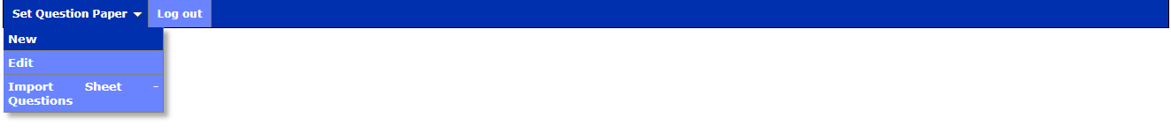
Click on “Set Question Paper” in New for Enter Question

Slide 13
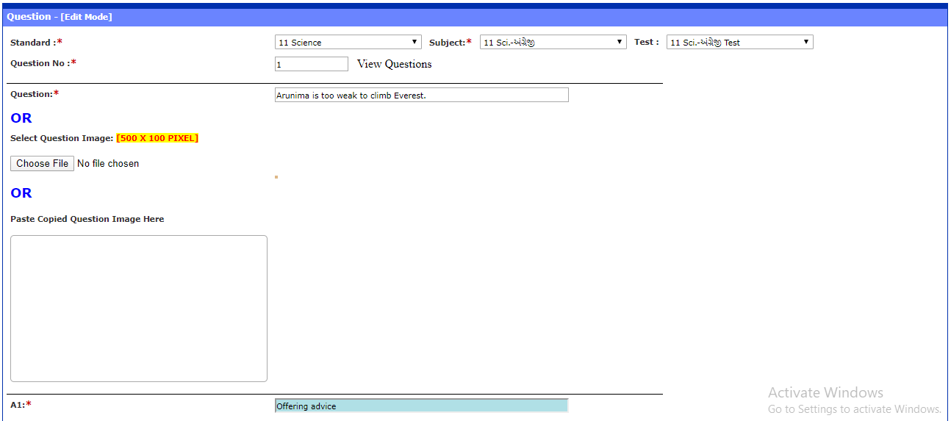
Enter question and answer detail with ‘Standard, Subject and Test Detail’

Slide 14
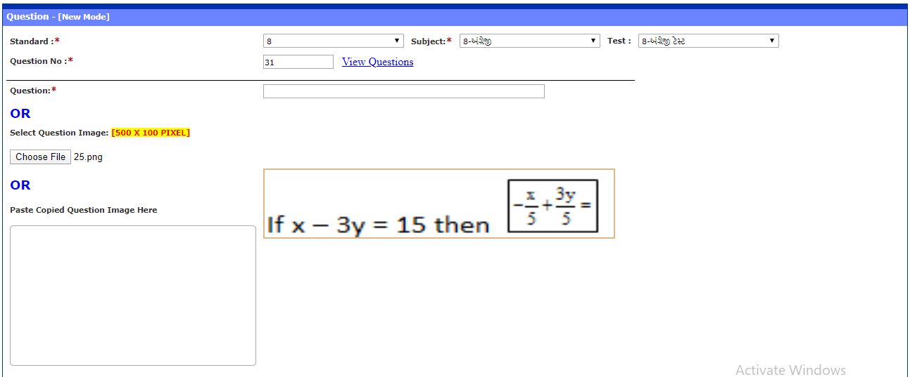
Enter question and answer detail with image. Also you can click on ‘Choose File’ than select question’s image

Slide 15
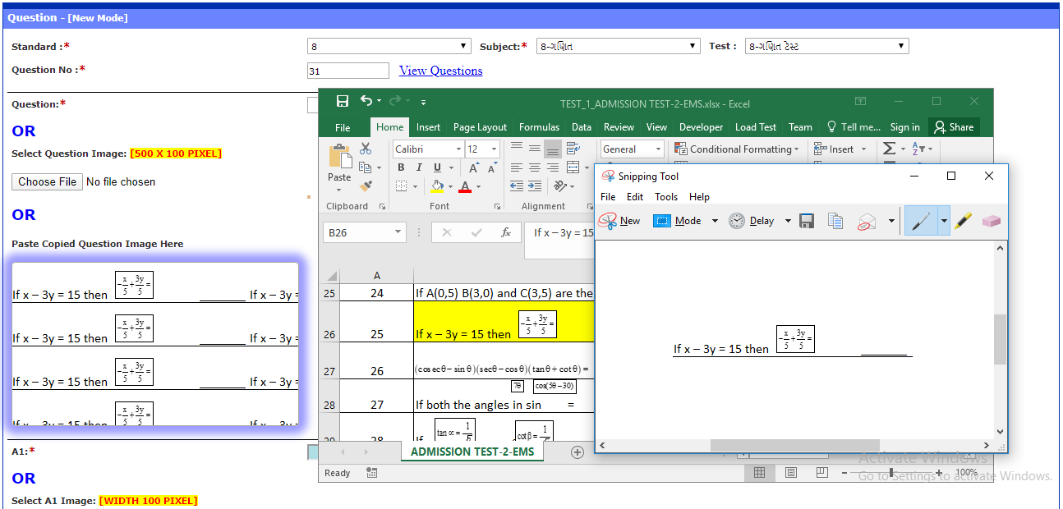
Enter question and answer using copy & paste image

Slide 16
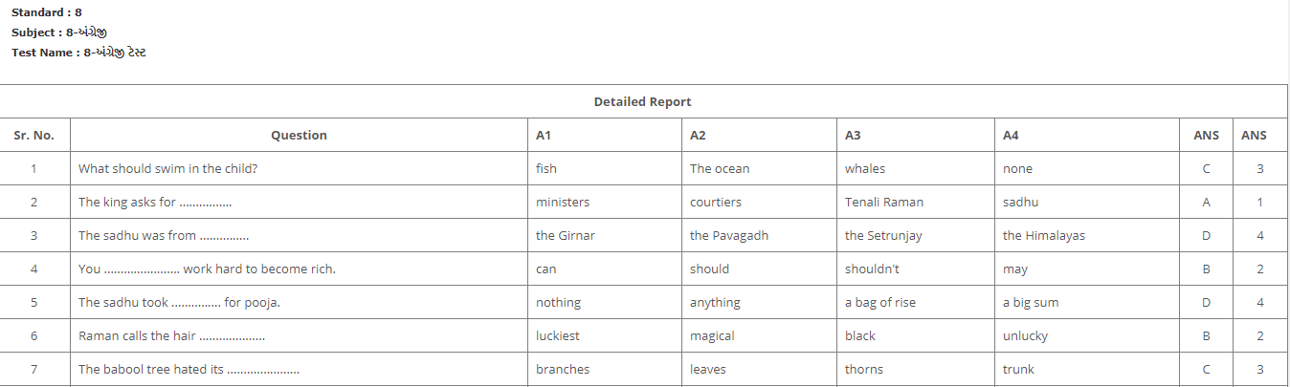
To check all questions list click on ‘View Questions’ link

Slide 17
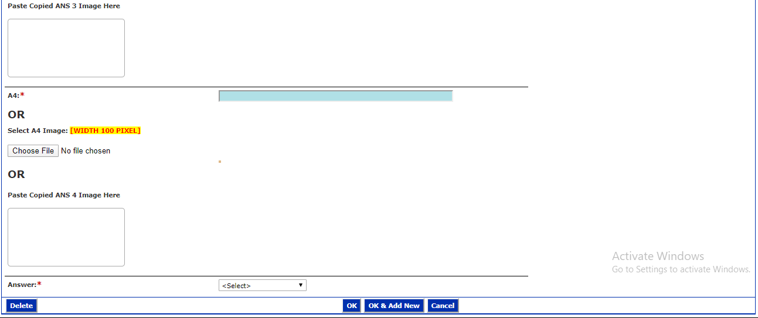
Click on ‘Ok & Add New’ button to save current question and add another question. Click on“Ok” button to save last question

Slide 18
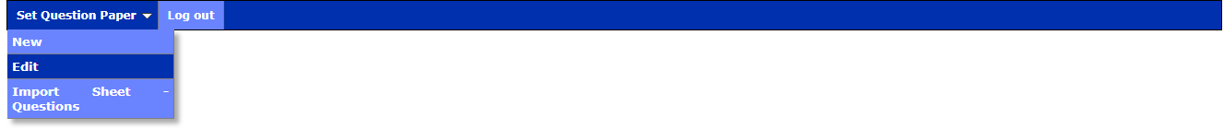
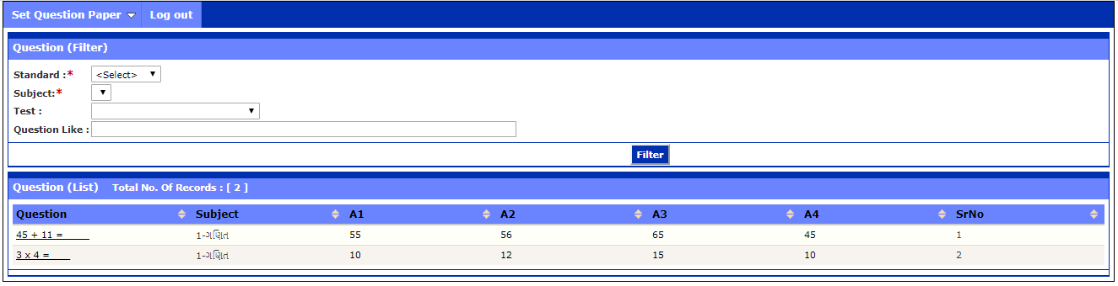
To edit question or answer, click on set question paper → Edit and than click on “Filter "Button.
Click on question which you want to edit and again after changes click on “OK” button

Slide 19
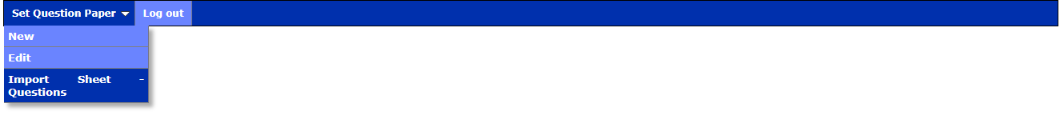
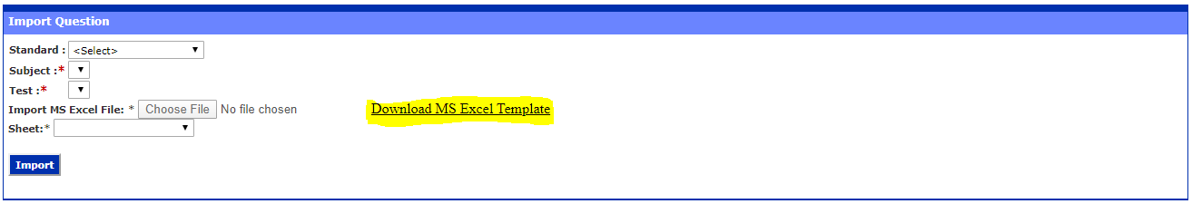
To import question via excel in Software, click on ‘Import Sheet – Questions’
Download Excel format for Question and Answer Detail using click on “Download MS Excel Template” and Fill Questions and Answer in that Excel

Slide 20
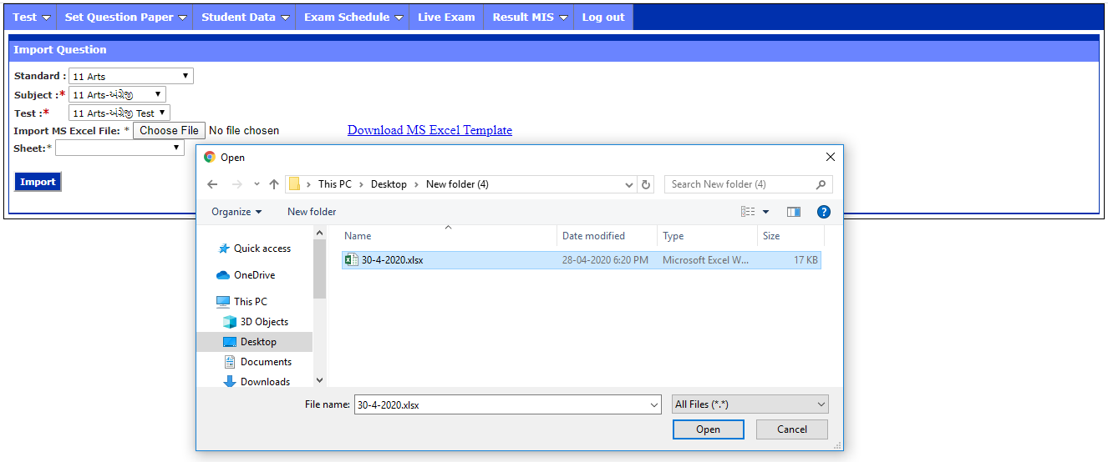
To import question via excel in software, click on “Import Sheet – Questions”
Download excel format for question and answer by clicking on ‘Download MS Excel Template’ and fill questions and answer in that excel

Slide 21
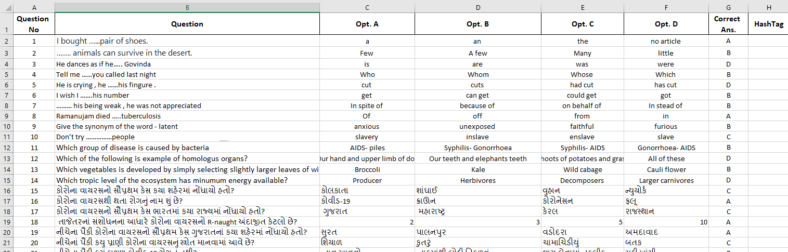
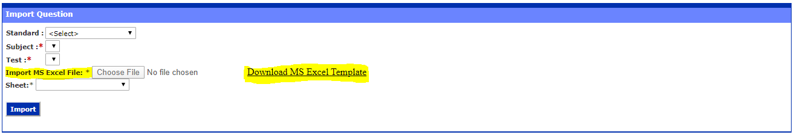
Click on “Choose File” to import questions file. After selecting excel file, click on ‘Import’ Button

Slide 22
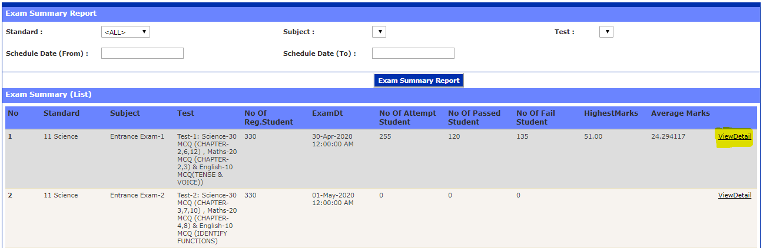
To check result MIS Report, click on ‘Result MIS - Exam Summary’ tab

Slide 23
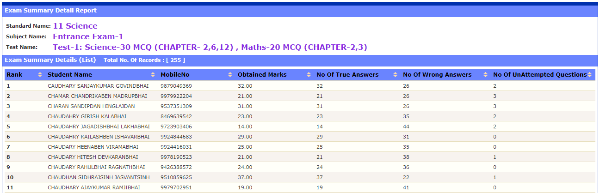
To check result, MIS Report Click on “Result MIS” in “Exam Summary” for Detail Click on “View Detail”

Slide 24
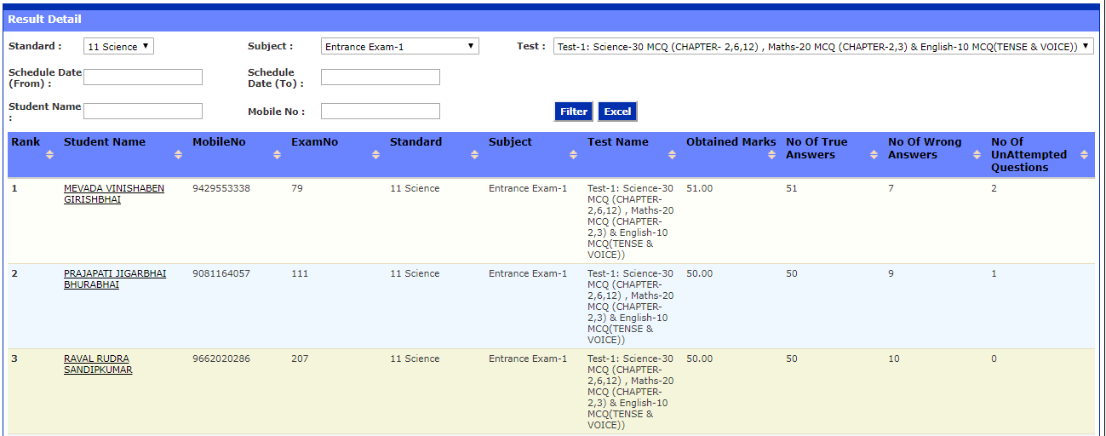
To check student registration wise report, click on ‘Result MIS →Registration Detail’

Slide 25
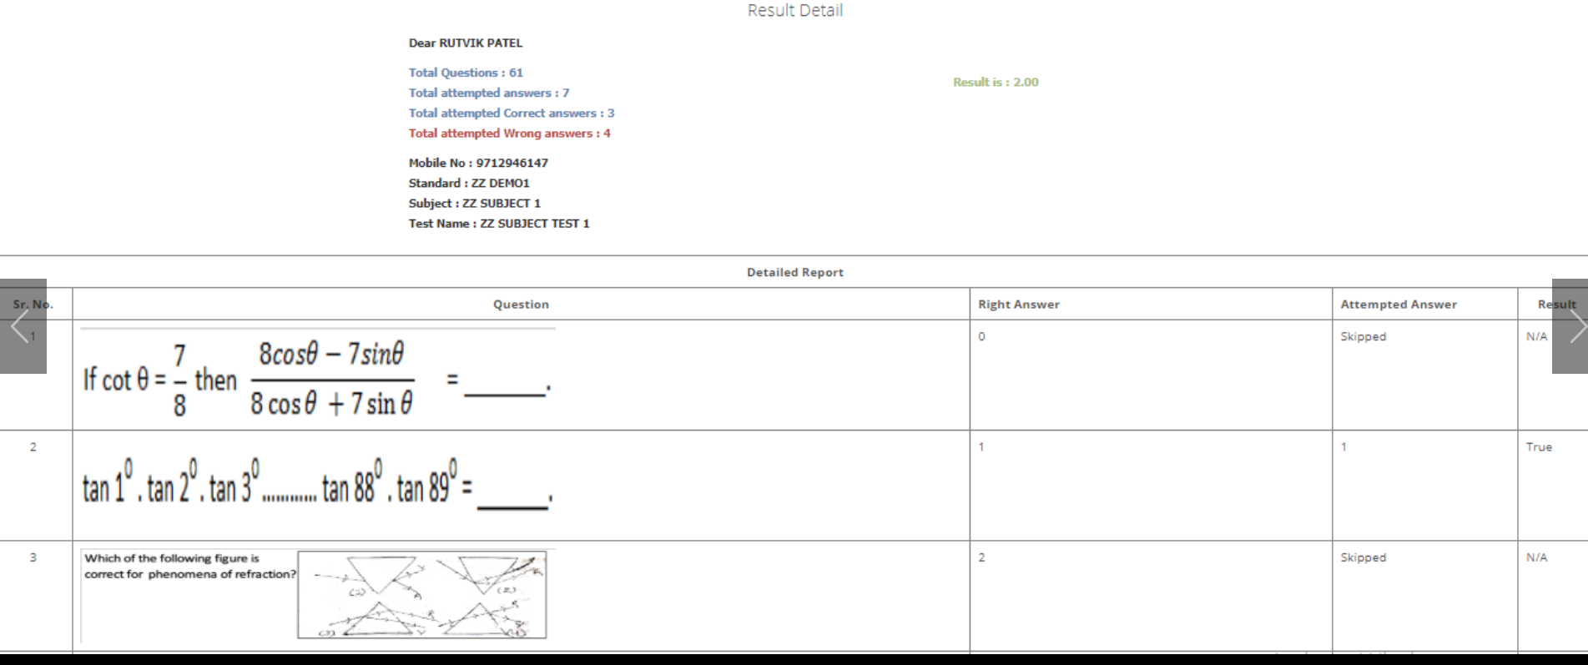
To check student registration wise report, click on ‘Result MIS →Registration Detail’

Slide 26
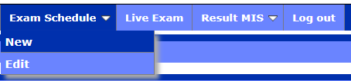
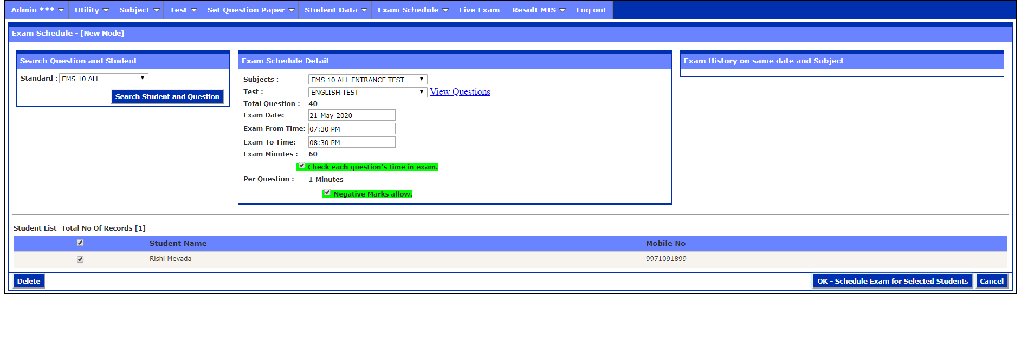
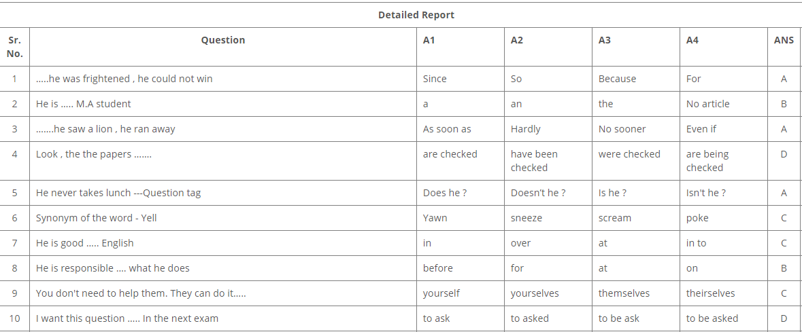
Exam Schedule

